Slide 1

Tic Tac TOE
Manasa Challa(00804892)
Renuka Malineni(00798164)
KaRimulla SHAIK(00805142)

Slide 2
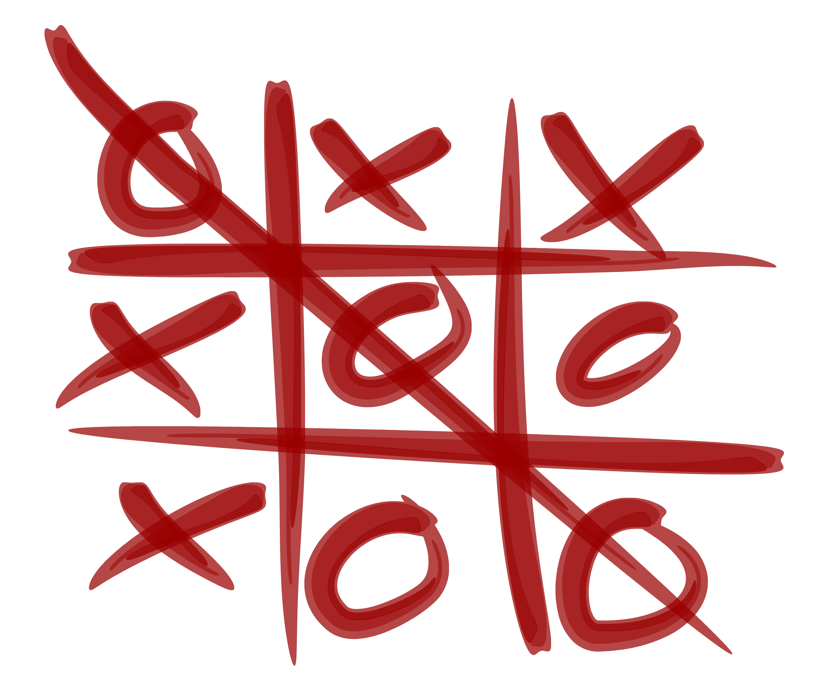
Tic-Tac-Toe Game Playing
Two Players(Traditional)
Human
Computer
In this model both players are bots/computers there is no human/user to play
what if both Intelligent Bots play
Who wins??????
Let’s see……

Slide 3

Tic tac Toe Board – (or Noughts and crosses, Xs and Os)
Tic tac Toe Board – (or Noughts and crosses, Xs and Os) A 3 x 3 grid has two players, X and O, who mark the spots in turn. The winner of the game is the player who successfully arranges three of their respective markers in a row that is either horizontal, vertical, or diagonal.

Slide 4

Approach
We plan to use the following tools and techniques to achieve our project objectives:
Programming language: Python
Game development framework: Pygame
Artificial intelligence: Minimax algorithm
• Data Structure
Consider a Board having nine elements vector.
Each element will contain
0 for blank
x indicating X player move
o indicating O player move
Computer may play as X or O player
First player who so ever is always plays X

Slide 5

What Algorithm was used and why?
Minimax Algorithm was used in this project. The Minimax algorithm involves a sequential process in which both players take turns to select a move with the highest score. The current player selects a move that maximizes their score, while the opponent determines the scores for each of their available moves by choosing the move with the lowest score. This back-and-forth process continues until the game ends, with the players trying to maximize their own scores and minimize their opponent's scores.

Slide 6
Objective
Notation “x” is used for input variables if the player X marks on the cells. Similarly, notation “o” is used if the player O marks on the cells.
When a cell is blank without any mark, “0” is used. For the Winner variable, it could be “x” if the player X gets three marks in a row.
“o” is stored if the play O is the winner.
It is built by computer so there will be no human error and absolute zero errors.
When comes to accuracy:
Bot 1: 54% (out of 100 games)
Bot 2: 46% (out of 100 games)
Since the following states are selected at random (from a random package), accuracy may vary.

Slide 7
Deliverables
Upon completion of this project, we will deliver the following items:
A working Tic Tac Toe game implemented in Python using Pygame
An unbeatable AI opponent at all difficulty levels
A user-friendly interface for playing the game
A comprehensive report documenting the design, implementation, and evaluation of the project

Slide 8
Evaluation Methodology
The success of our project will be evaluated based on the following criteria:
Functionality: Does the game work as intended? Can it be played against the AI opponent at all difficulty levels?
Difficulty: Is the AI opponent challenging and unbeatable at all difficulty levels?
Usability: Is the game easy to learn and play? Is the user interface intuitive?
Visual appeal: Is the game visually appealing and engaging?
Report quality: Is the report comprehensive, well-written, and clearly documents the design, implementation, and evaluation of the project?
To evaluate these criteria, we will conduct the following activities:
Playtest the game: We will playtest the game extensively to ensure that it is functional, challenging, and easy to use.
Evaluate the AI opponent: We will evaluate the AI opponent against a variety of human players to ensure that it is unbeatable at all difficulty levels.
Review the report: We will have an independent reviewer review the report to ensure that it is comprehensive, well-written, and clearly documents the design, implementation, and evaluation of the project.

Slide 9
Evaluation Methodology
Define the state space: Represent the tic-tac-toe board as a state in a format that the neural network can understand.
Define the action space: Determine the possible actions that the agent can take in a given state, such as placing an 'X' or an 'O' in a specific cell.
Implement the neural network architecture: Design a neural network that takes the current state as input and outputs the probability distribution over possible actions and an estimation of the value function.
Train the network: Use the A3C algorithm to train the neural network. This involves running multiple agents simultaneously, each exploring the environment and updating the shared parameters of the neural network.
Update the policy and value functions: Adjust the policy and value functions based on the rewards obtained during the training process, using the advantage estimation to update the network's parameters.

